Slide 1
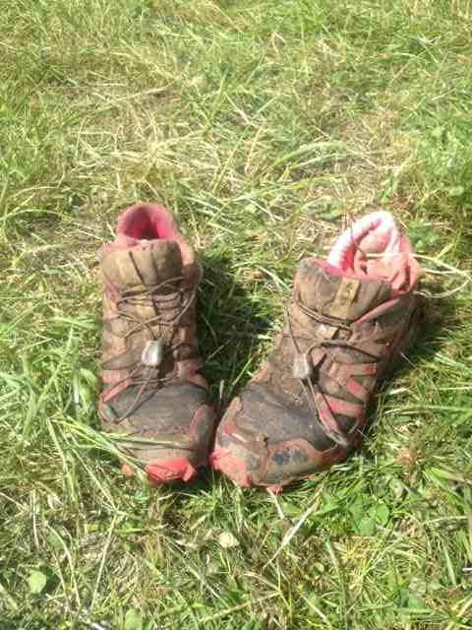
UK South Cross Country
Fixtures 2022/23
Date | Race | Venue
05 Oct 22 | League Race 1 | 11 Sigs/13 Sigs, Blandford Camp, Blandford Forum
19 Oct 22 | League Race 2 | 21 Signal Regt., Azimghur Bks, Colerne
16 Nov 22 | League Race 3 | TBC
30 Nov 22 | UK South Cross Country Individual and Team Championships | 3 RSME Regt, Gibraltar Barracks, Minley
04 Jan 23 | League Race 4 | TBC
18 Jan 23 | League Race 5 | 1 Signal Regt., Swinton Bks, Perham Down
01 Feb 23 | League Race 6 | 24 Cdo RE RMB Chivenor Barnstaple
01 Mar 23 | League Race 7 | 1 RRF, Mooltan Barracks, Tidworth
22 Mar 23 | League Race 8 | DSPG, Southwick Park, Portsmouth
UK SOUTH CROSS COUNTRY COMMITTEE
Chairman – Lt Col Mansfield
Secretary – Sgt (SI) Osman Muskwe RAPTC
Osman.Muskwe952@mod.gov.uk
01252 787166
Assistant Secretary – SSgt (SSI) Scott Caine RAPTC
Scott.Caine402@mod.gov.uk
01258 485441
Any male or female [military or civilian] interested in competing cross country
for their units/service are asked to contact their unit RAPTCI or cross country sports officer.

